Slide 1
Introduction to Programming Using Python

Slide 2
Objectives
Programming to non-programmers
Demonstrate Operations and Methods
Enable and energize new programmers
Learning by doing

Slide 3
Instructor – Ray Smith raysmith@alum.mit.edu
Years of Programming – engineering, scientific, financial
Commercial, Scientific, Systems Languages – C, C++, Perl, Java, Python, Assembly
NEW - Games for very young 3-8 years

Slide 4
Telling the Computer What to Do
The language, PYTHON, is the rules
Popular, Powerful, and EASY
Like most human languages - Don’t have to know all

Slide 5
Computer = VERY Obedient Servant
Car Example
Most cars are alike
Does what you tell it – hopefully what you want
Same response every time – almost – e.g. forward / backward
Car gets the blame…

Slide 6
Similar activities
Abstract / Indirect
Cooking recipes
Travel directions
Assembly instructions
Physical – What you see is what you get
Construction - Roads, Buildings

Slide 7
Like Computer Programming
Build once – use many times
Builder and user(s) often different
Building errors show up many times
Mistakes don't always show up immediately

Slide 8
Not so like Computer Programming
Physical materials
Hard to copy
Hard to manipulate
Easy to see

Slide 9
What's Easy – No so physical
Creation / copying / moving is a snap
Don't wear out
Change easy
Work on new, while using old

Slide 10
What's Not Easy – because No so physical
Can't "see" it
Everything connected – unexpected consequences
Not easy to tell how close to done

Slide 11
Our Sandbox – python’s IDLE
https://www.python.org
Download latest python 3.7.0
Python shell
Documentation
IDE - editor, execution, debugger

Slide 12
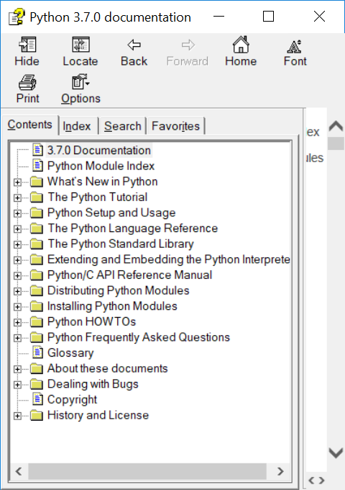
IDLE – Lots of Nice STUFF

Slide 13
Download Python
www.python.org
Instructions: pythonorg.docx

Slide 14
IDLE – continued
Look around – Help ➔ Python Docs
Play with shell 2 + 2, PRESS ENTER

Slide 15
IDLE – continued
Create file File ➔ New File
… add text
File ➔ Save
Maybe in folder “classwork” ???
Reuse - File ➔ Save As…

Slide 16
Hello World!
Create file
File ➔ New File + File ➔ Save As…
File ➔ Recent Files + File ➔ Save As…

Slide 17
Hello World! - continued
Write simple program:
print("Hello World!")
print("My name is Ray.")
Save file – File ➔ Save
Run program – Run ➔ Run Module

Slide 18
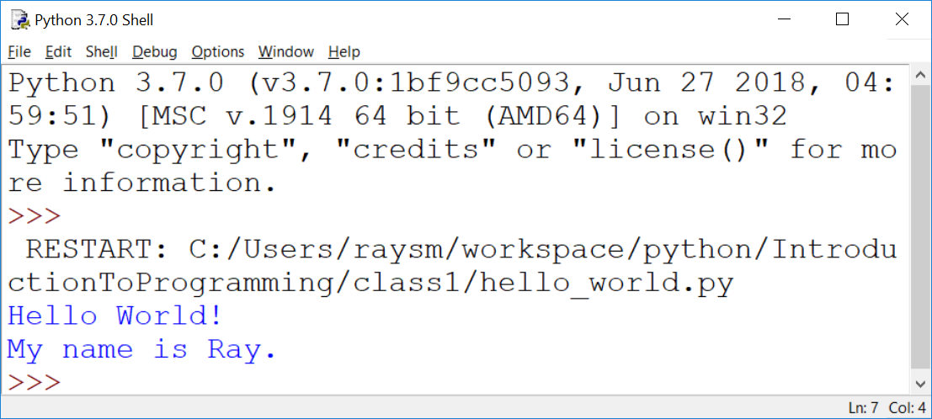
Hello World! - output

Slide 19
Python Language - Minimum
# Comment – Just say it
# "#" to the end of line
# Not executed but what is wanted
""" Doc Strings – Multiple lines """
"""
Good to start and end
on empty lines
"""

Slide 20
Python Language - continued
Arithmetic almost like algebra class : +,-,*, >, >=, ==
BUT single “=” is for assignment
max_value = 20
value = value + 5
in = pr * (1+rate)**years

Slide 21
Python Language – print function
Prints one or more values
Separate values by commas (,)
print("Hello")
Print("value: ", 10)
print("Maximum: ", max)

Slide 22
Python Language - Testing
“if” condition “:”
One or more indented lines
if value > max_value:
print("value", value, " is big")
print("Try less than", max_value)

Slide 23
Python Language - Looping
“while” condition “:”
One or more statements indented
to the SAME indentation
while value < max_value:
print("value ", value, " is OK")
Value = value + 10
print("value is now", value)

Slide 24
Exercise: “Times Tables” for 13 – 1x13, 2x13, …,13x13
Hints:
Create new file named “timestable.py”
Set, that is name and initialize variables – first, last, running
Use “while”
print(n, "x ", val, " = ", n * val)

Slide 25
Python Language – input function
Just get user input
inp = input()
Prompt user first
inp = input("Please enter:")
Convert to Integer
nval = int(inp)

Slide 26
Exercise: “Times Tables” – with user giving number
Hints:
Use “timestable.py” as start
New file name = “timestableN.py”
Replace “13” with variable “nval”
Use inp = input("Enter mult:")

Slide 27
Exercise for LATER: “Times Tables” – Full table from 1x1 to NxN
Hints:
timestableN.py → timestableNbyN.py
How to do it by hand?
How many loops?
What are the variables?

Slide 28
A Program We Can do
I’m thinking of a number …
Simplification - Helps the user
Get guess - tell if greater, less, equal
Iteration - learn along the way

Slide 29
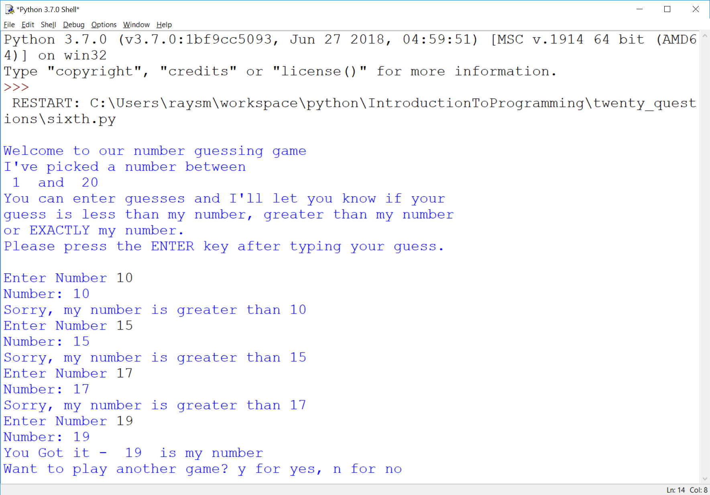
Here’s the goal

Slide 30
Guessing Game – Iteration 1
Create new file named “first.py”
Do the smallest part
Loop, asking number
Print number entered

Slide 31
Guessing Game – Iteration 1 - continued
Hints:
Place comments describing task
Use while True:
What variables?
Use string = input("…")

Slide 32
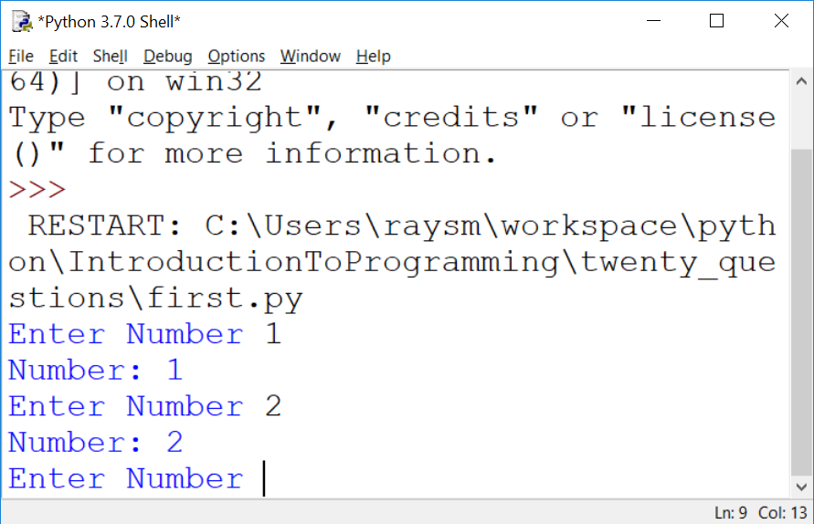
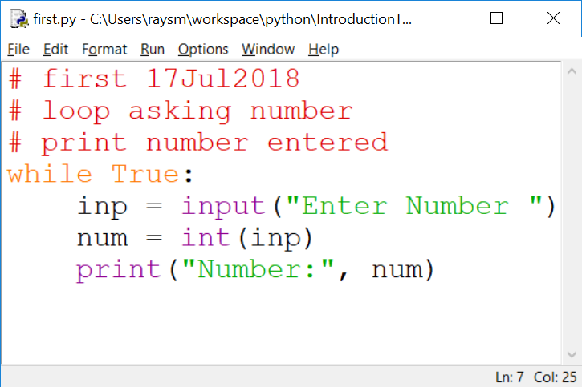
The First Iteration

Slide 33
Second Iteration – A bit More
Set target value
Quit if number entered number equals target
Hints:
Start from first.py
Use break to quit while loop

Slide 34
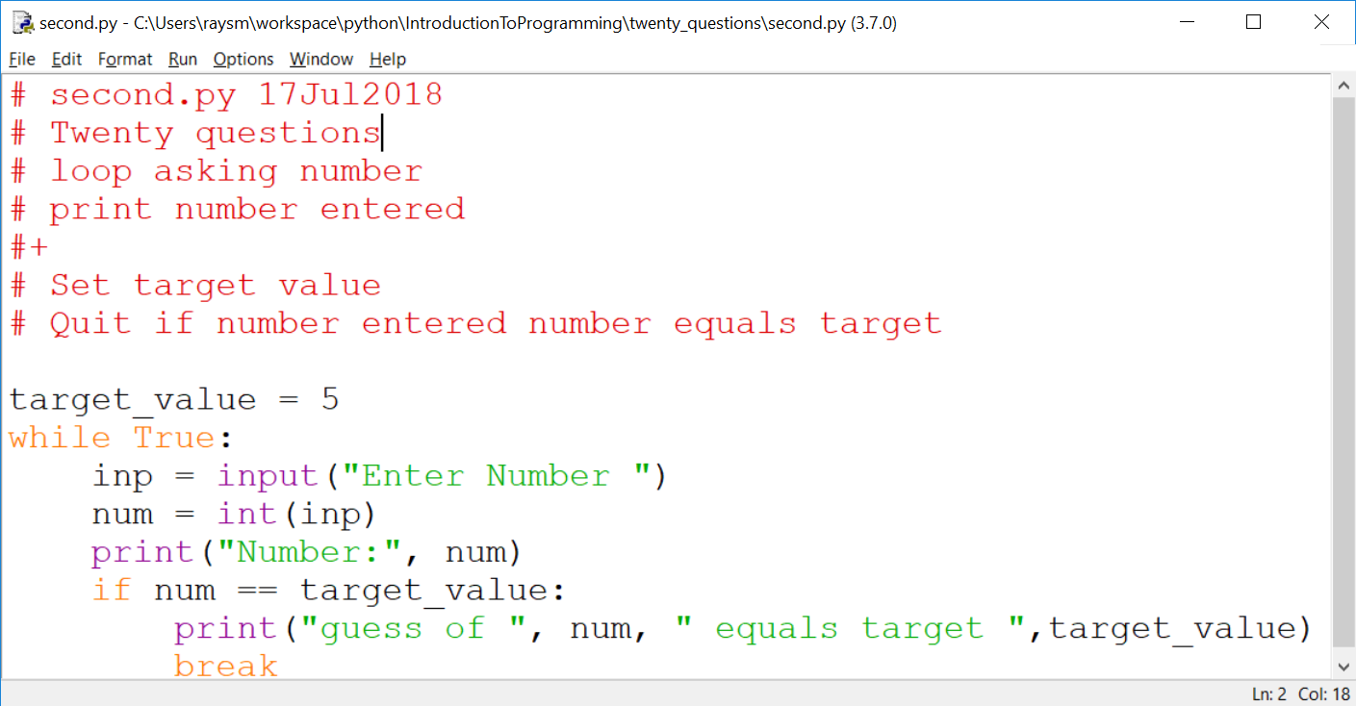
Second Iteration – continued

Slide 35
Think of the Iterations Early
First:
loop asking number
print number entered
Second:
Set target value
Quit if number entered number equals target

Slide 36
Think of the Iterations - continued
Third: Say if guess greater, less or equal
Fourth: Say goals, rules before start
Fifth: Ask user if they want to play again
Sixth: Set target to random number

Slide 37
More Python – Variables Places to store values
Eases the use/reuse our data/results
Names have rules:
Start with a letter (a-zA-Z_)
Followed by zero or more digits (0-9) or letters
OK - a, a1, my_variable, a2or3
NOT - 1, 1a, my-variable, "ray,smith"

Slide 38
Python Language Guidelines with some exceptions
A statement is on ONE line
YES:
sum = 1 + 2
NO:
sum = 1 +
2
Parenthesized grouping may be on multiple lines
YES: sum = (1
+ 2)

Slide 39
Python Language Guidelines - continued
A group of statements:
Are executed in order
Must start at same indentation (from left)
BUT Parenthesized grouping may have any indentation within the parentheses

Slide 40
Python Language Guidelines - continued
YES:
start = 1
last = 3
increment = 1
NO:
start = 1
last = 3
increment = 1

